Slide 1
A Functional Language for Parallel Computing
Zhenbang You
3/16/2023
https://github.com/ZhenbangYou/A-Functional-Language-for-Parallel-Computing

Slide 2
Goal and Roadmap
Design and embed a DSL in Scala3
Generate CUDA code
Keep APIs functional and simple
If possible, don’t add new constructs
Try to bridge the performance gap
Performance
Safety
Productivity
Ideal

Slide 3
Goal and Roadmap
Design and embed a DSL in Scala3
Generate CUDA code
Keep APIs functional and easy-to-use
Try to bridge the performance gap
During the design and implementation, I am discovering more and more issues to be resolved
Performance
Safety
Productivity
In Reality

Slide 4
Pipeline
Functional DSL
(Embedded in Scala3)
Run Scala Program
CUDA Code
(Global and Device Functions)
Compile & Run on GPU
Final Result

Slide 5
Feature Summary
Primitive types: float, int, bool
Can also be cast implicit from corresponding Scala type
Array type: 1D float array
Expression type: float, int, bool, and array
Operators
Arithmetic: +, -, *, /, %, unary +, unary –
Logical: ==, !=, <, <=, >, >=, &&, ||, !
Programming paradigms
Functional programming
map, zip with, reduce in block
Array programming
Type system
Struct type check at Scala compilation time
Automatic type inference for return value
Type safety for compiler development
Memory safety
Bound check
Shared memory support
Support for indices

Slide 6
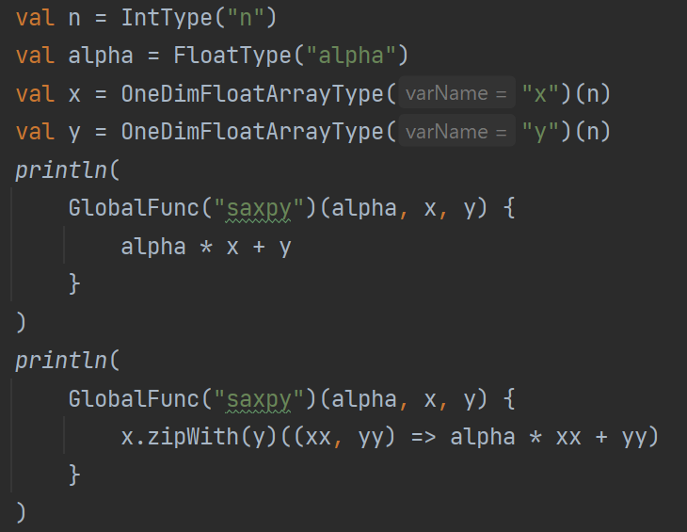
Examples

Slide 7
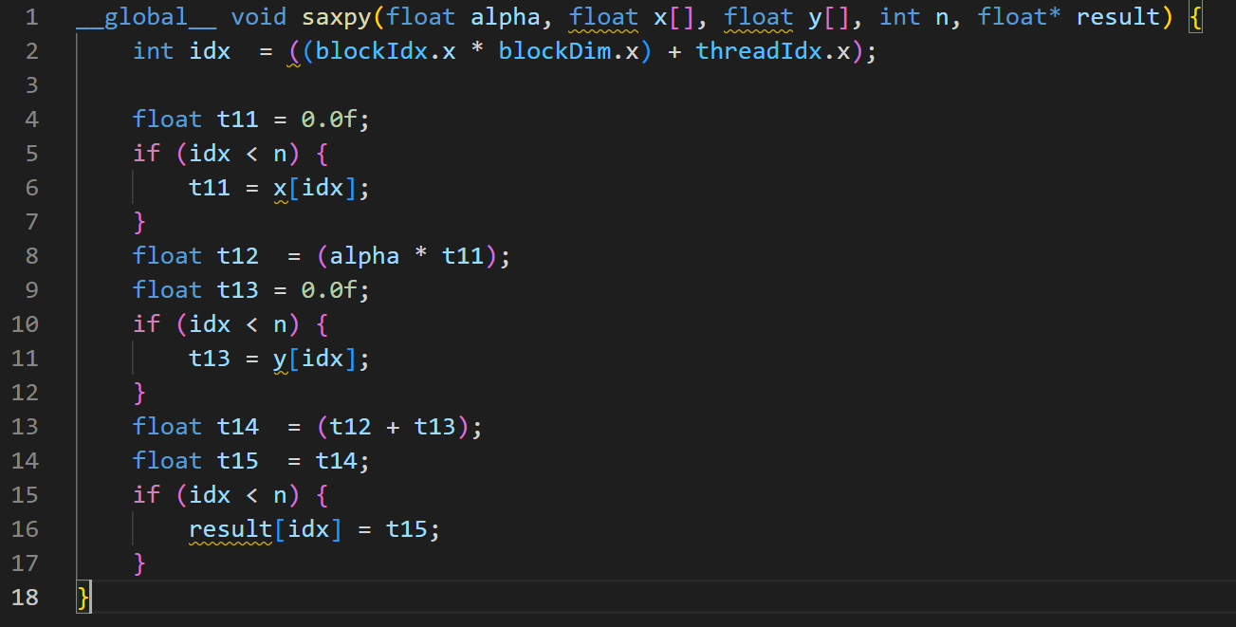
Examples

Slide 8
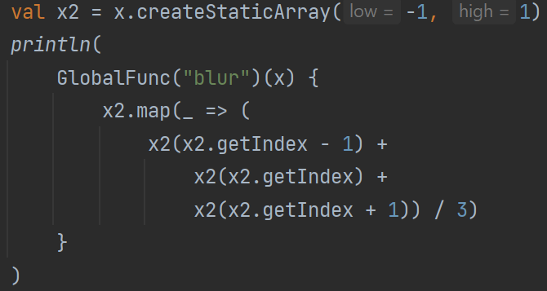
Examples

Slide 9
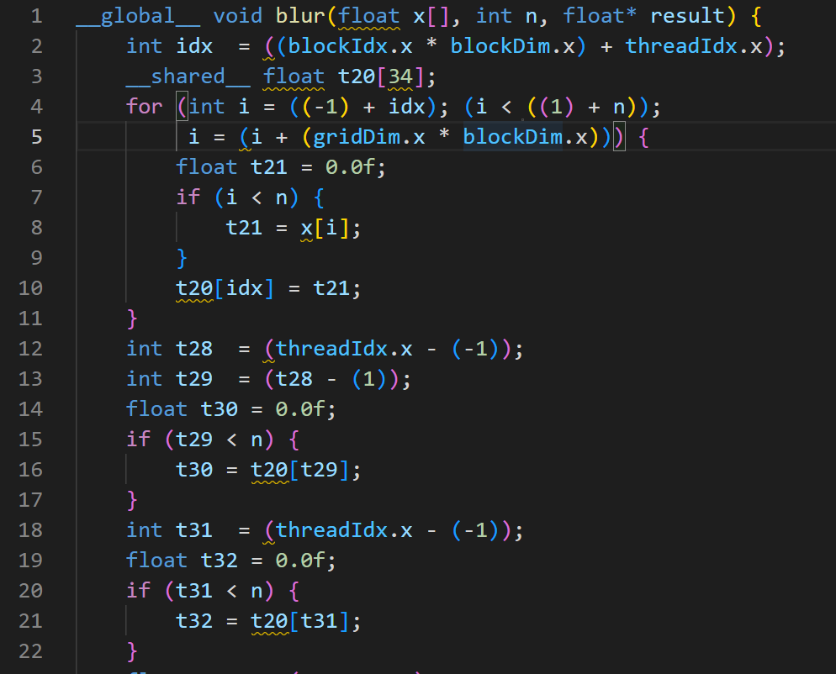
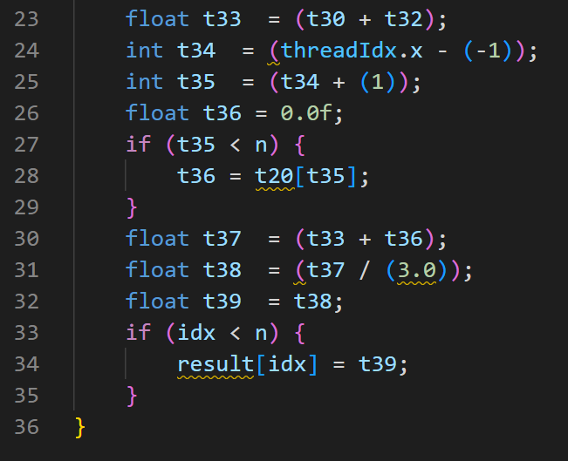
Examples

Slide 10
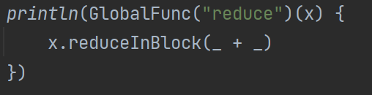
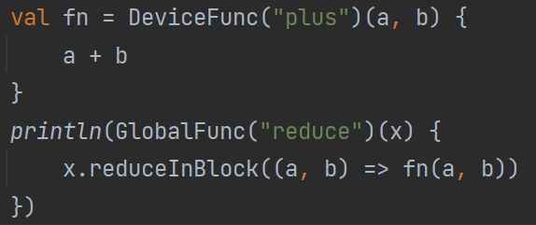
Examples

Slide 11
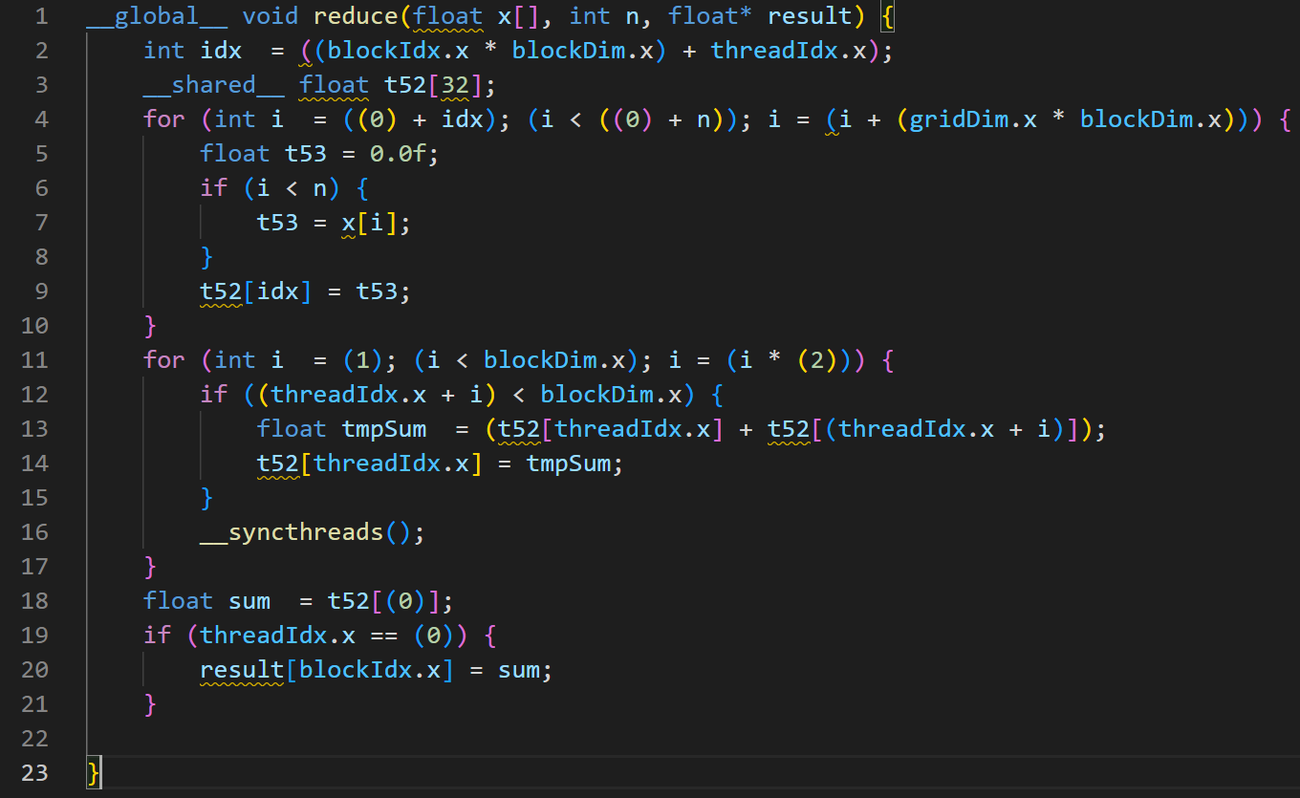
Examples

Slide 12
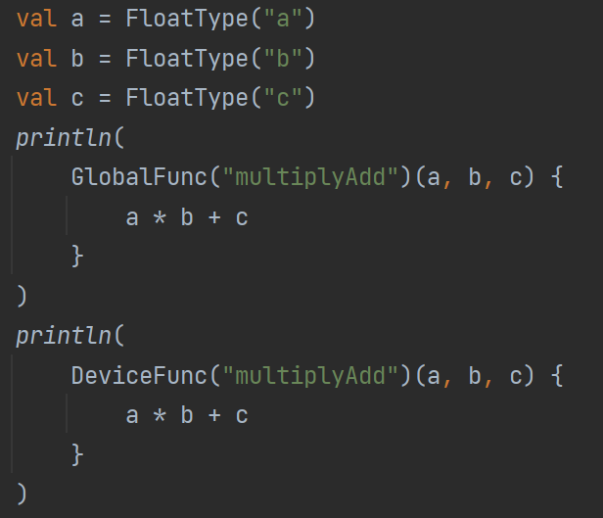
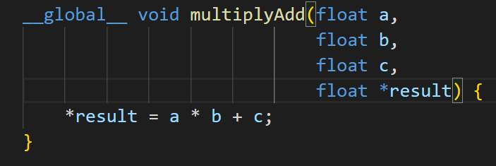
The First Tough Issue: Expression-Oriented to Statement-Oriented
The body of function in the DSL is an expression
It seems fine for scalar variables

Slide 13
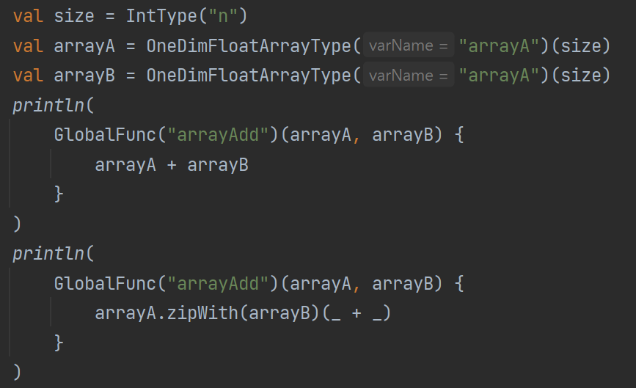
The First Tough Issue: Expression-Oriented to Statement-Oriented
What about array operations?

Slide 14
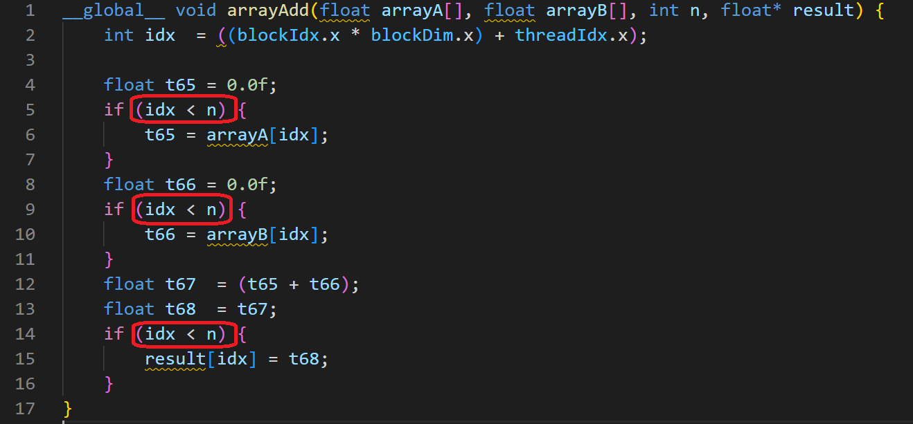
The First Tough Issue: Expression-Oriented to Statement-Oriented
What about array operations?

Slide 15
The First Tough Issue: Expression-Oriented to Statement-Oriented
What about array operations?
Conditional result!
Some threads should be idle
In particular, need some way to record the condition of the return value
Scala Set

Slide 16
The First Tough Issue: Expression-Oriented to Statement-Oriented
Due to the difference of style, it seems to me that the gap between functional languages and CUDA is larger than the gap between C and assembly code
How to bridge this?

Slide 17
The First Tough Issue: Expression-Oriented to Statement-Oriented
Due to the difference of style, it seems to me that the gap between functional languages and CUDA is larger than the gap between C and assembly code
How to bridge this?
IR!

Slide 18
Intermediate Representations to Rescue
Two levels of IRs
Higher one: ExprIR (Expression IR), expression-oriented
Lower one: StmtIR (Statement IR), statement-oriented
Overloaded Operators
“genStatement” method
“codeGen” method
Source
Code
ExprIR
StmtIR
CUDA Code
(Text Format)

Slide 19
ExprIR (Expression IR),
Basically, AST nodes of expressions
Transformation from DSL source code to ExprIR is done by overloading operators
E.g., create class “Add”, when “a+b” is evaluated, “Add(a, b)” will be created.
Type check: “a” and “b” must have the same type, so does the result (type inference for the return value is done here)
Further details in the discussion of the type system

Slide 20
StmtIR (Statement IR)
Just a few construct to model CUDA statements
Assignment/ArrayStoreWithoutBoundCheck
Declaration/InitializedDeclaration/DeclareStaticArray
IfThen/IfThenElse
WhileLoop/ForLoop
SyncThreads
Func
These are all strictly typed checked

Slide 21
Design Principles of the Compiler
Generic design
Reduce boilerplate code
Strict type check for both the DSL and the compiler
Delay generating text as possible
Purely functional
Make it easier to port to other host languages

Slide 22
Type Safety & Type Hierarchy
Except the last layer, everything is a trait
No class inheritance
Type
UnitType
ScalarType
FloatType
IntType
ArrayType[T <: ScalarType]
OneDimFloatArrayType
TmpOneDimFloatArrayType

Slide 23
Type Safety & Type Hierarchy
Except the last layer, everything is a trait
No class inheritance
Expr
PolyExpr[T:Type]
FloatType, IntType, UnitType
Add[T], Sub[T], … (arithmetic operations)
Ternary[T]
ArrayAccess/ArrayAccessWithoutBoundCheck/TmpArrayAccess
FunctionApplication
BoolExpr
EQ[T], NE[T], … (comparison operations)
And, Or, Not (logical operations)

Slide 24
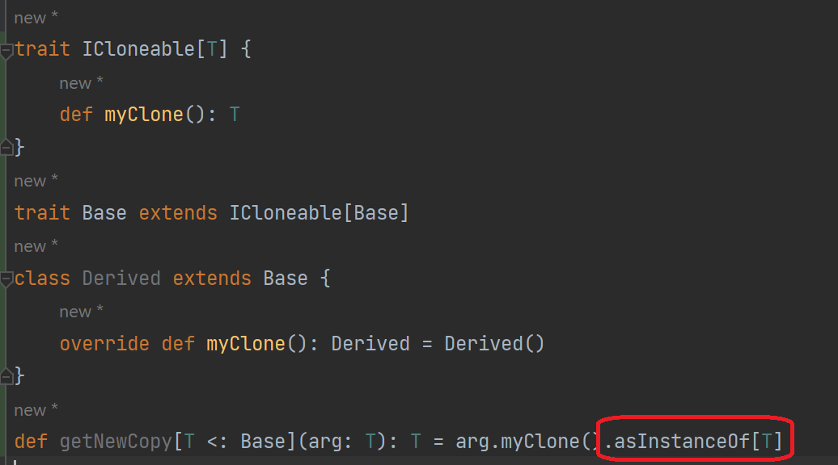
Weaknesses of Scala Generics
No “this/self” type
Solution: down casting
Consequence: compilation-time type safety is compromised

Slide 25
Weaknesses of Scala Generics
Doesn’t support static method in trait
Solution: convert into member method (add dummy “this” argument)
Consequence: cannot call the method without an instance
Fortunately, we always have such an instance in this project

Slide 26
Weaknesses of Scala Generics
Aside
The above two are common issues for most of mainstream PLs
Haskell and Rust resolve them

Slide 27
Weakness of Type Safety for External DSLs
Device functions (class “DeviceFunc”) can be applied
But the type compatibility of actual arguments and formal parameters is hard to check at host language compile time (Scala -> CUDA)
Rationale: number of arguments is unbound, so this cannot be solved by generic tuples

Slide 28
Memory Safety
Solution: compulsory bound check at each memory access
Weakness: possible redundant bound check
Can be removed by the CUDA compiler

Slide 29
Memory Hierarchy
Memory hierarchy of CUDA
Registers
Local memory (off-chip DRAM)
Shared memory (on-chip SRAM)
Global memory (off-chip DRAM)

Slide 30
Support for Shared Memory
Crux: different indices for array in global memory and shared memory. E.g.,
Global memory: blockIdx.x * blockDim.x + threadIdx.x
Shared memory: threadIdx.x
Solution: add “getIndex” method for ArrayType

Slide 31
Synchronization
Analogous to two kinds of dependencies in Spark
In the dependency graph
Narrow dependency: a node has only one child, e.g., map, zip
Wide dependency: a node has multiple children, e.g., join, group by
Array operations in CUDA
Dependencies within a thread
Simple, no need to sync, intermediate results can be kept in registers (if the length is fixed)
Dependencies within a block (intra-block dependencies)
Not hard, sync by CUDA intrinsic (__syncthreads), intermediate results can be kept in shared memory
Dependencies among blocks (inter-block dependencies)
Hard, sync when functions end

Slide 32
Synchronization Hierarchy
Computation Hierarchy | Memory Hierarchy | Synchronization Hierarchy
CUDA thread | Register | No need to sync
Block | Shared memory | __syncthreads()
Grid | Global memory | No sync primitives

Slide 33
Feelings about Scala as a Host Language
Generally, good, recommended
Very expressive and flexible
Collections are good
A few drawbacks
Two aforementioned weaknesses of generic
Possibly limited by JVM
Slow compilation speed

Slide 34
Still a Long Way to Go …
Basic part
Synchronization among blocks
Have one CUDA thread operate on multiple elements
Tough issue: size of shared memory
Remove unnecessary bound check
Advanced part
More radical optimization for memory hierarchy
Better integration of functional style and Halide style
Auto-scheduling
I am still developing it

